Slide 1
https://codeburst.io/algorithms-i-searching-and-sorting-algorithms-56497dbaef20

Slide 2
CSS143 Computer Programming (II)

Slide 3
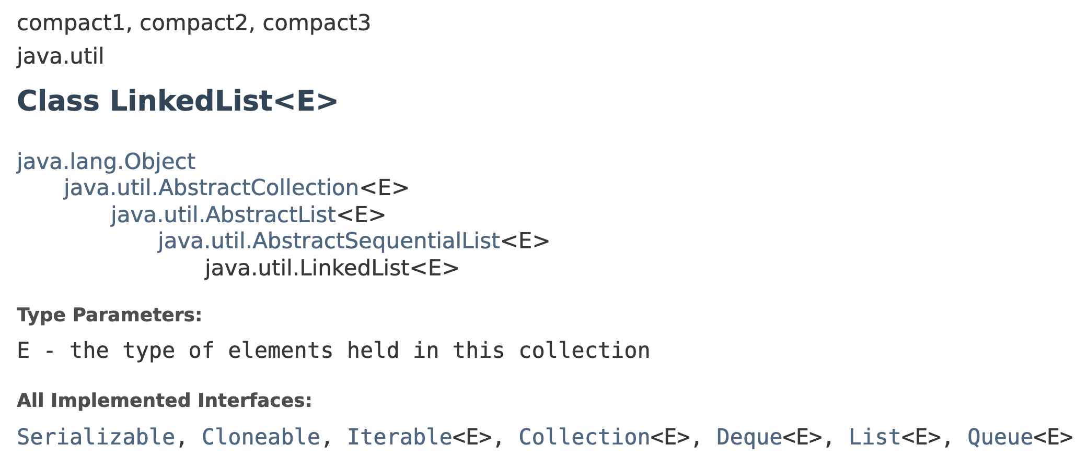
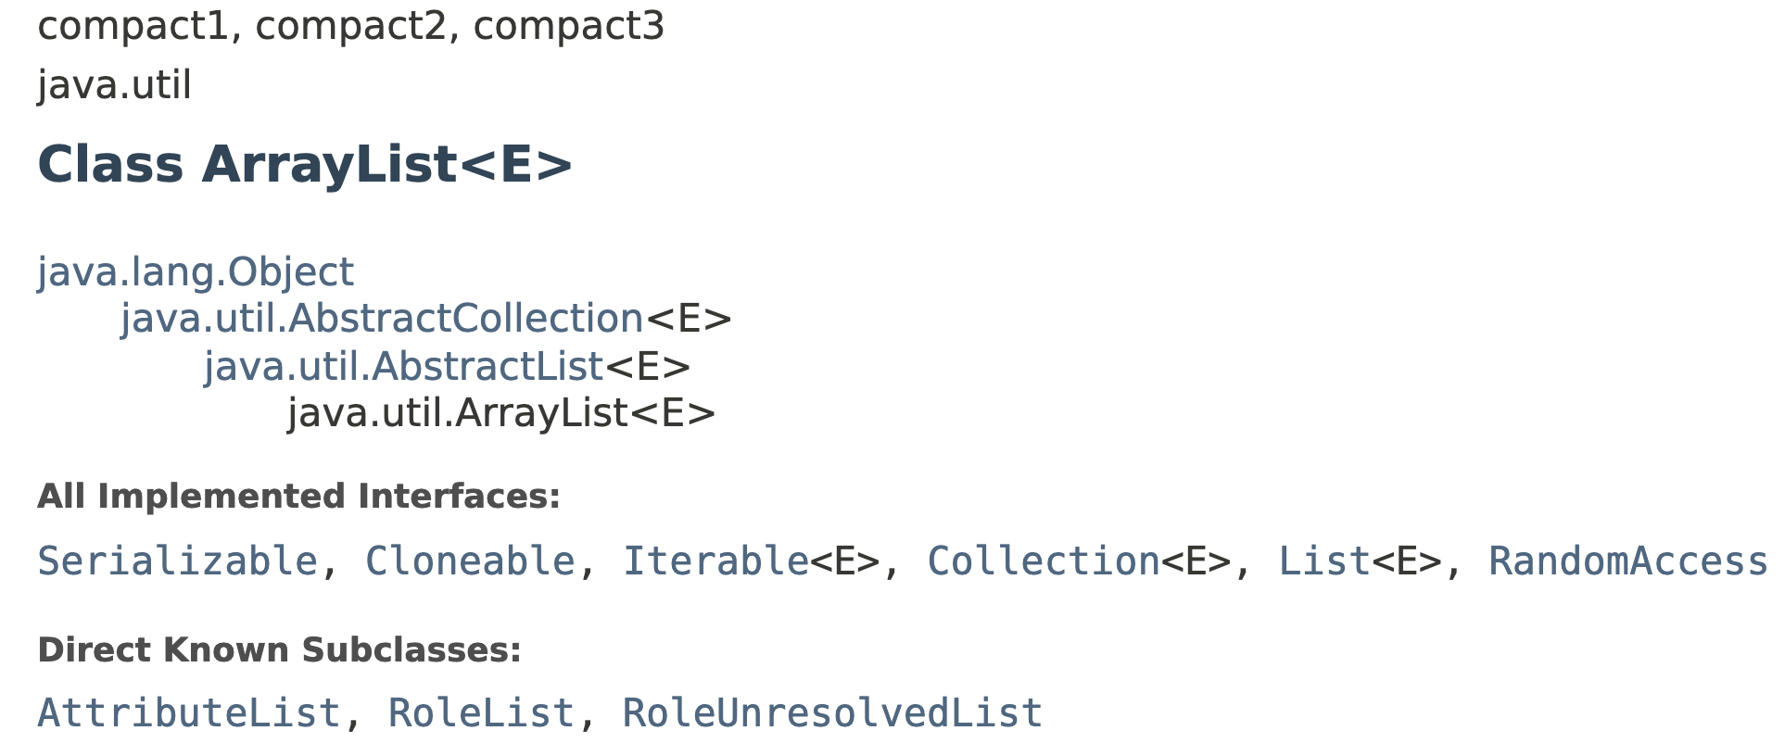
ADT List
What’s the difference between this two classes?

Slide 4
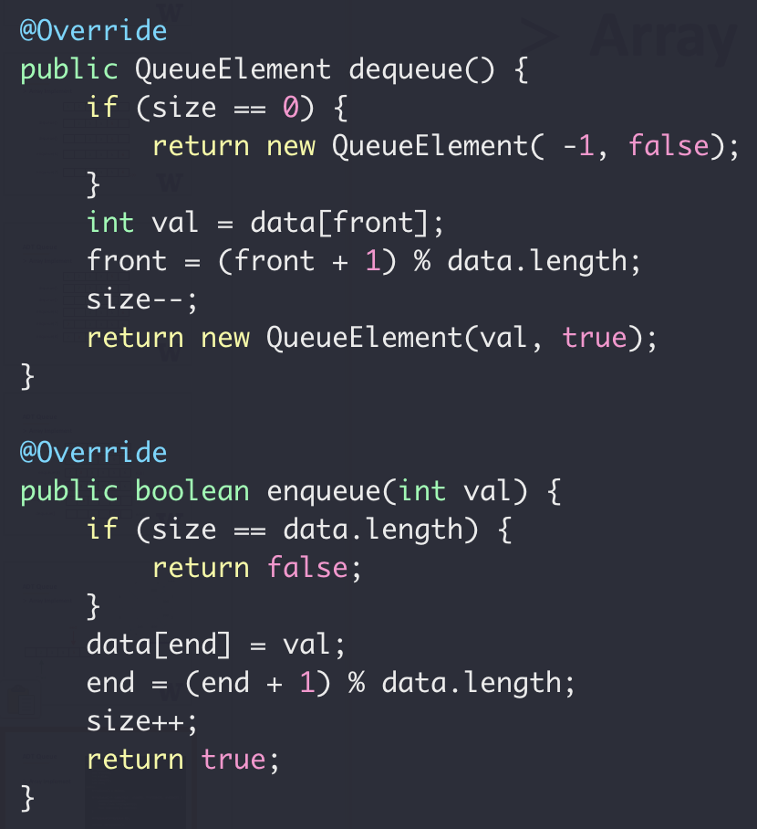
ADT Queue
Array Implement

Slide 5
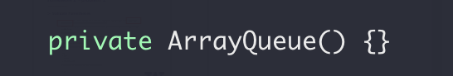
ADT Queue
disable default constructor

Slide 6
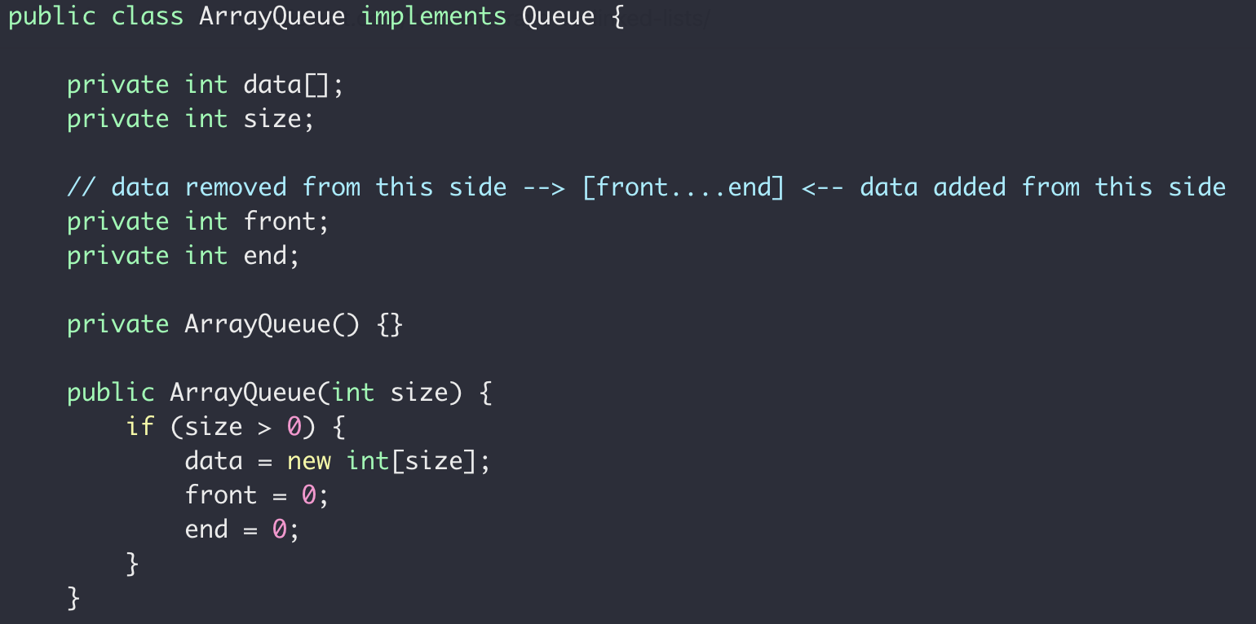
ADT Queue

Slide 7
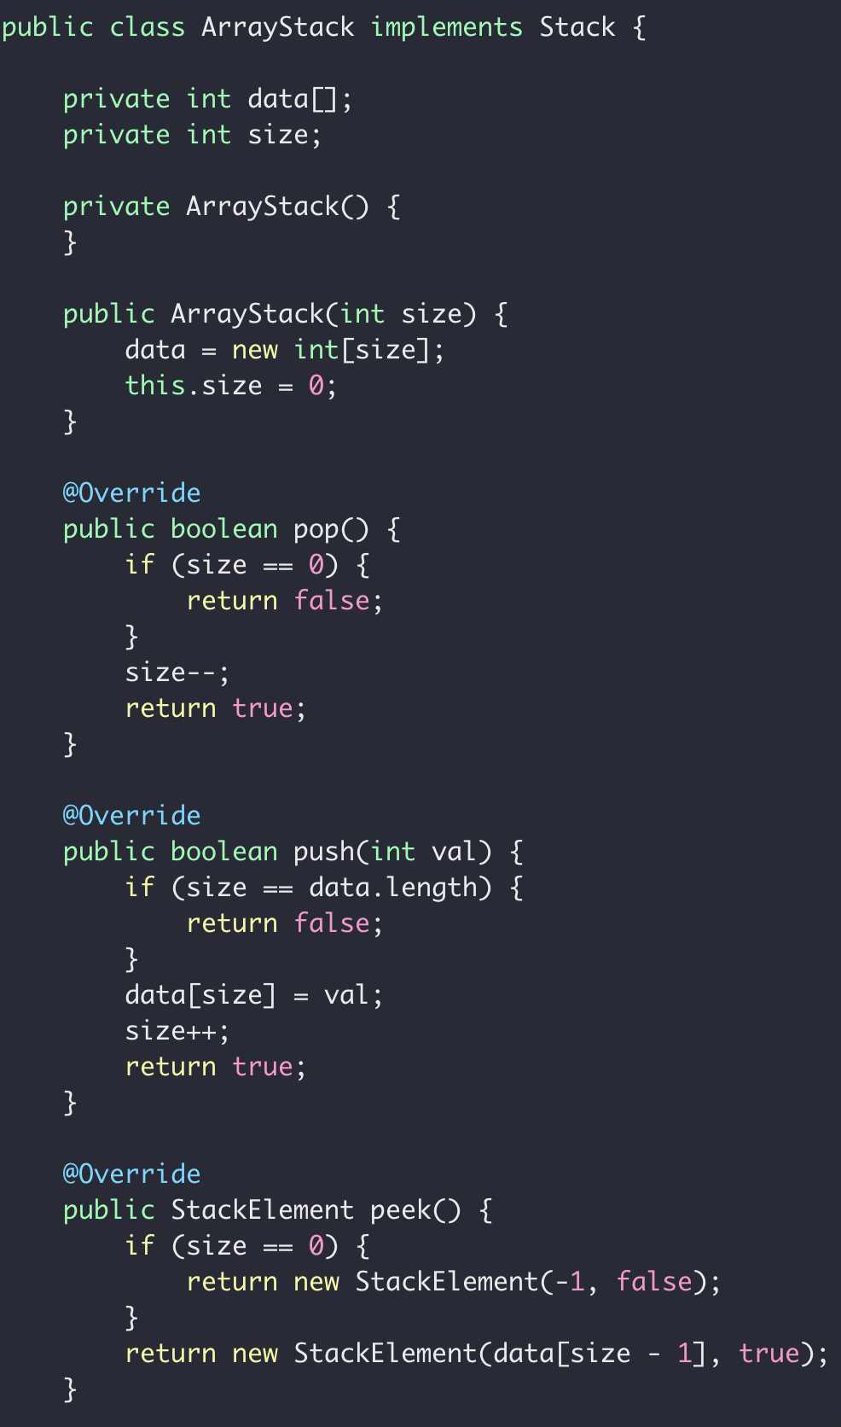
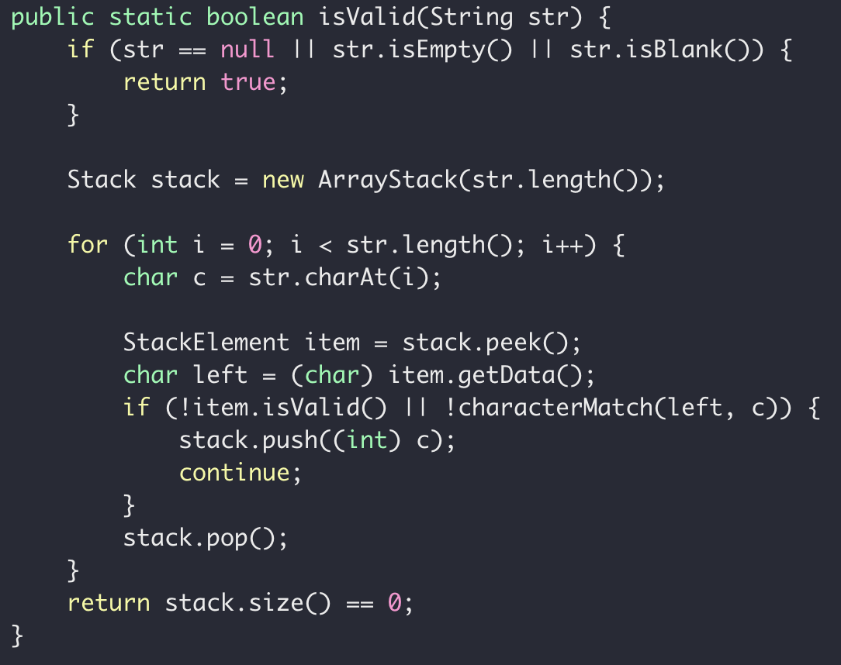
ADT Stack

Slide 8
ADT Queue
Remove the limitation of queue size
Option 1: Better/smarter Algorithm
Option 1: Better/smarter Algorithm
Option 2: Different data structure

Slide 9


Array vs List
12
12
1
7
18
10
3
0
1
2
3
4
5
6
Bookshelf

Slide 10
Array → List
12
12
1
7
18
10
3
head
12
12
12
1
7
18
10
3
value
“Node”
reference

Slide 11
Memory Layout
addr0
12
addr1
addr8
addr2
addr3
addr4
7
addr0
addr5
addr10
addr1
12
addr6
head
addr2
12
addr0
addr7
addr3
12
1
addr8
addr4
1
addr4
addr9
addr5
7
18
addr10
addr6
18
addr11
addr14
addr7
10
addr12
3
addr8
3
addr13
null
addr9
addr14
10
addr10
addr15
addr12
array
list
addr16

Slide 12
Array vs List
Array:
Contiguous in memory
Fast random access
Fixed size
12
12
1
7
18
10
3
head
12
12
1
7
18
10
3
null
LinkedList:
Random addressed in memory
No random access
Size not fixed
More comparison between array and linked list

Slide 13
Single Linked List vs Double Linked List
head
12
12
1
7
18
10
3
Single/Singly Linked List
null
head
12
12
1
7
18
10
3
null
null
Double/Doubly Linked List

Slide 14
Linked List
“interface”
head
12
12
1
7
18
10
3
null
add(value) : Add a node in the end addFirst(value) : Add a node in the beginning
removeFirst() : Remove a node from the beginning removeLast() : Remove a node from the end
getFirst() : Return the first node getLast() : Return the last node
size() : Size of the list

Slide 15
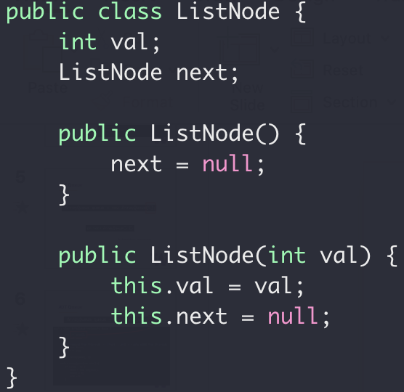
Linked List
“Implementation”
Next
Next
Next
Next
end
“Node”
value
reference

Slide 16
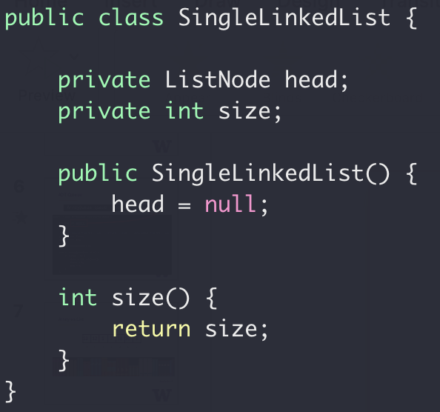
Single Linked List
“Implementation”
Next
Next
Next
Next
end

Slide 17
Single Linked List
Now let’s fill in the funcitons:
add(value) : Add a node in the end addFirst(value) : Add a node in the beginning
removeFirst() : Remove a node from the beginning removeLast() : Remove a node from the end
getFirst() : Return the first node getLast() : Return the last node
size() : Size of the list

Slide 18
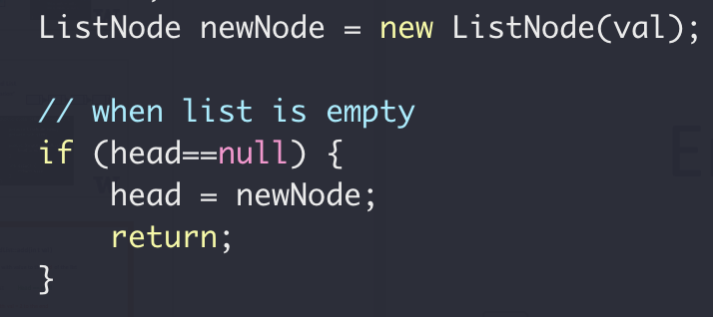
SingleLinkedList::add(int val)
Add a node with value to the end of the list
Empty List
Head == null
Add a node with val = 2 to the end
val = 2
Head
null
Next

Slide 19
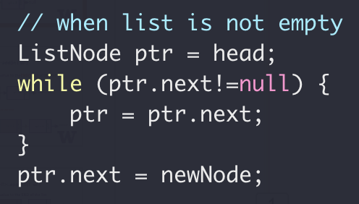
SingleLinkedList::add(int val)
Add a node with value to the end of the list
val = 2
head
null
Next
Add a node with val = 3 to the end
val = 2
val = 3
head
Next
null
Next
null

Slide 20
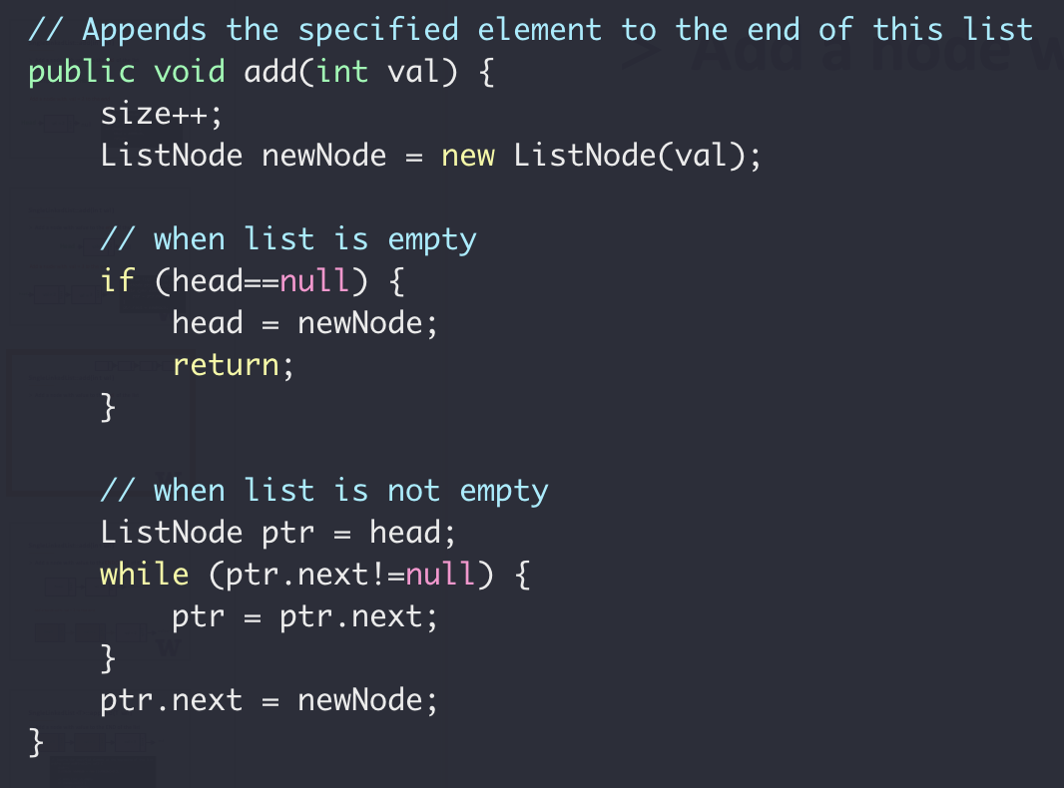
SingleLinkedList::add(int val)
Next
Next
Next
Next
end
Add a node with value to the end of the list

Slide 21

SingleLinkedList::addFirst(int val)
Add a node to the beginning of the list
val = 2
val = 3
head
null
null
Next
Next
val = 1
Next

Slide 22
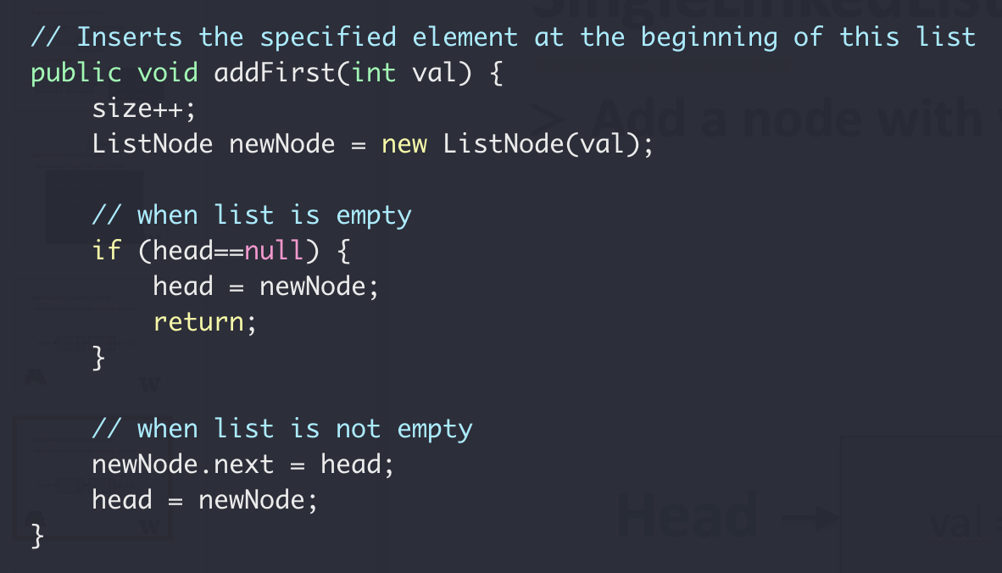
SingleLinkedList::addFirst(int val)
head
Next
Next
Next
Next
end
Add a node to the beginning of the list

Slide 23
SingleLinkedList::removeFirst(int val)
Remove the first node of the list
val = 2
val = 3
head
null
null
Next
Next

Slide 24
SingleLinkedList::removeFirst(int val)
Remove the first node of the list
Empty List
head == null
None-empty List
head
val = 2
val = 3
null
null
Next
Next

Slide 25
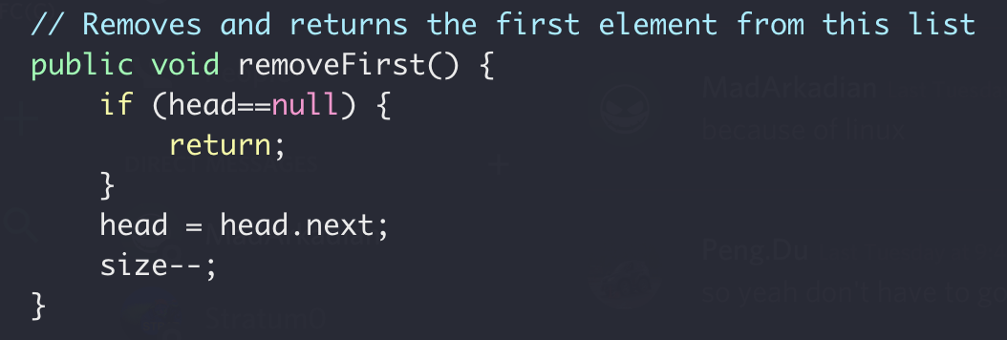
SingleLinkedList::removeFirst(int val)
Remove the first node of the list

Slide 26
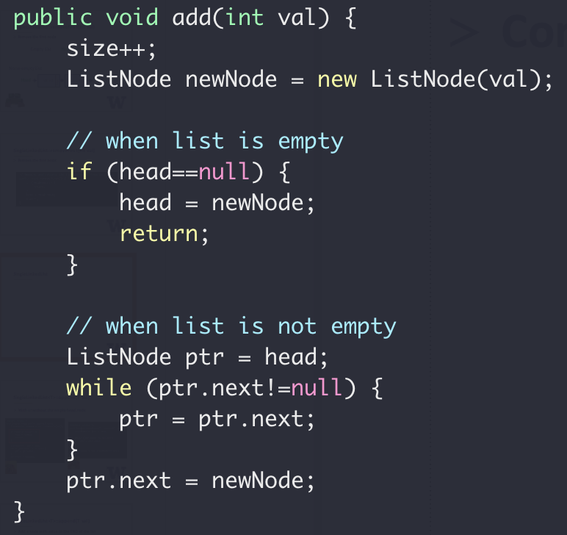
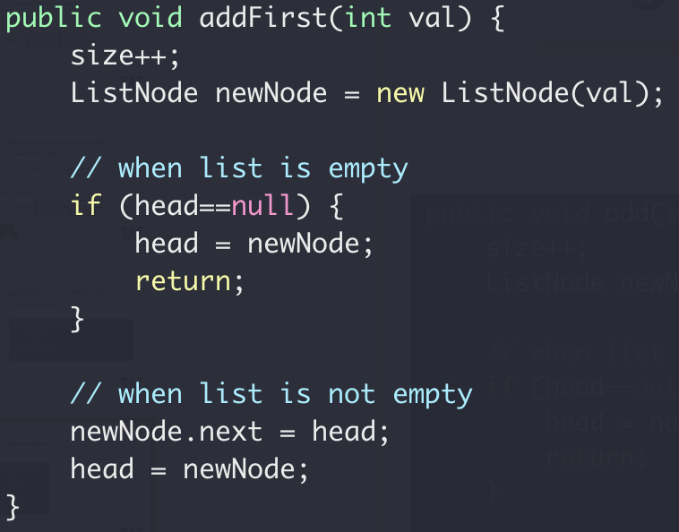
SingleLinkedList
head
end
Next
Next
Next
Next
Special case for empty list
Full code

Slide 27
SingleLinkedList
Sentry/dummy node
head
val = 2
val = 3
null
null
Next
Next
val = 2
val = 3
head
Next
null
null
Next
Next
Sentry/dummy node
Always exists since list creation
Value is not used

Slide 28
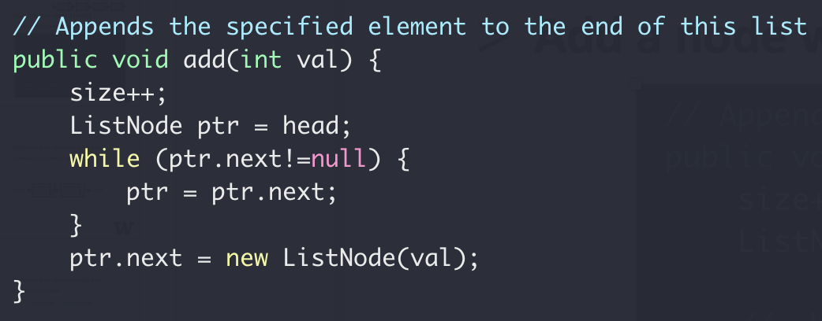
SingleLinkedList::add(int val)
Add a node with value to the end of the list
With sentry node

Slide 29
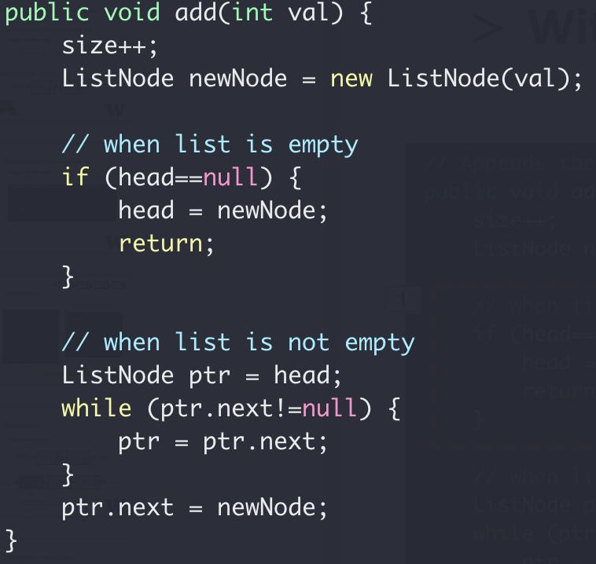
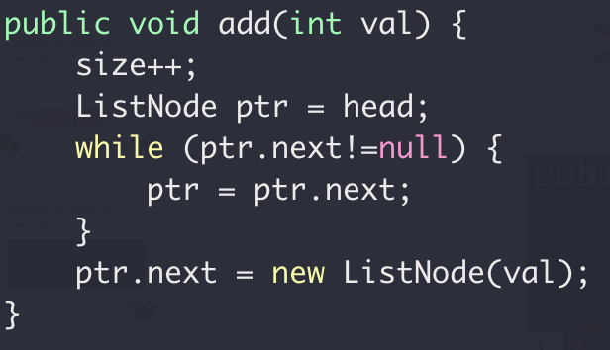


SingleLinkedList::add(int val)
Add a node with value to the end of the list
With sentry node
Full code

Slide 30
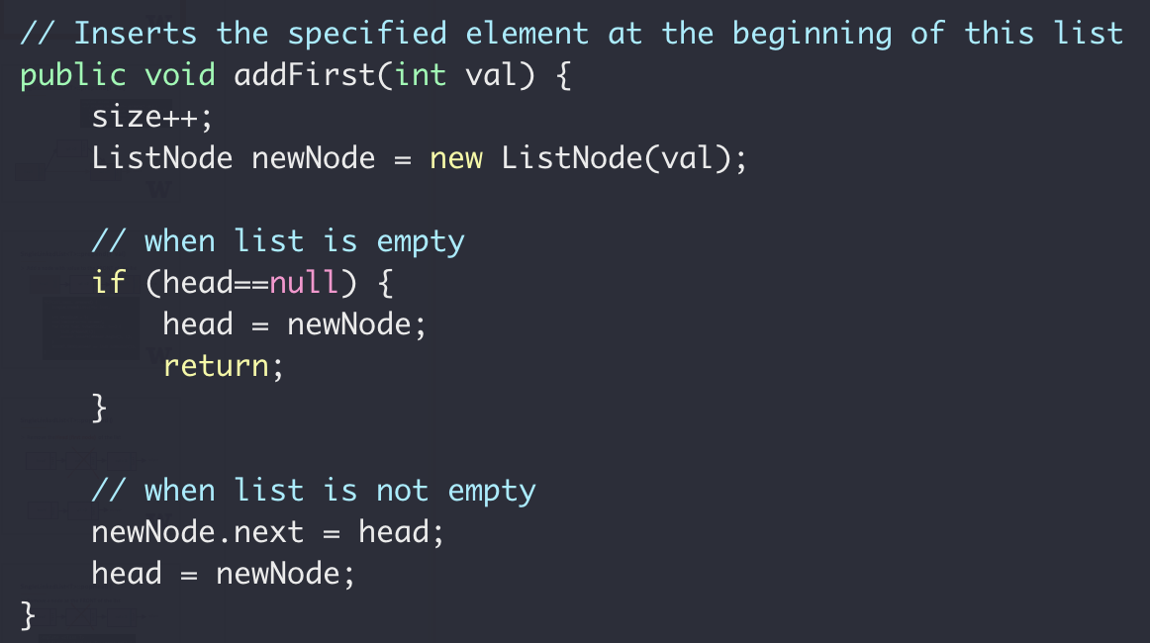
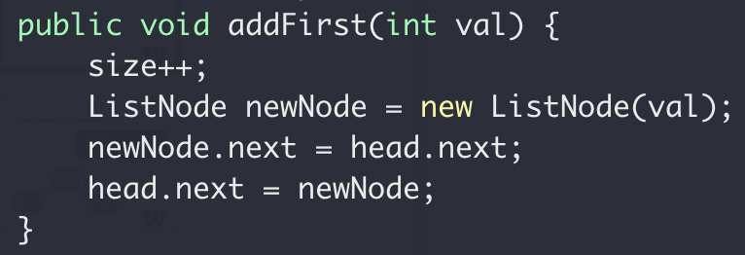
SingleLinkedList::addFirst(int val)
Add a node to the beginning of the list

Slide 31
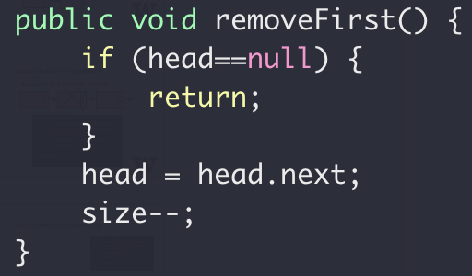
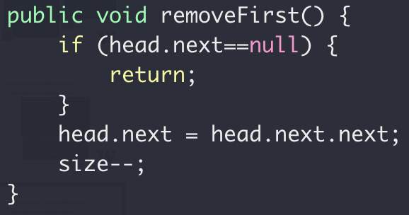
SingleLinkedList::removeFirst(int val)
Remove the first node of the list

Slide 32
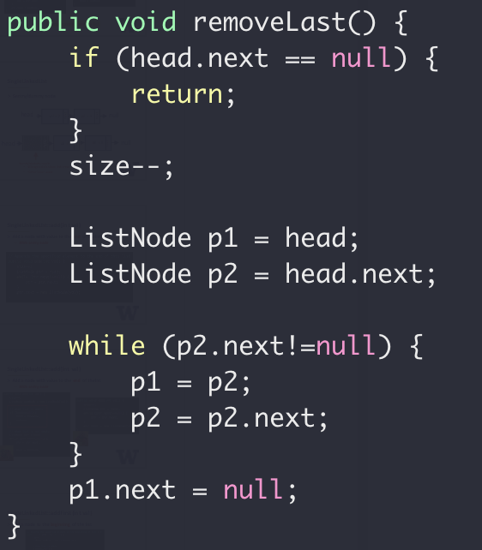
SingleLinkedList::removeLast()
Use sentry node
?
h → 2 → 5 → N
p1
p2

Slide 33
SingleLinkedList::removeLast()
Use sentry node
h → 2 → 5 → N
h → 2 → N
p1
p2

Slide 34
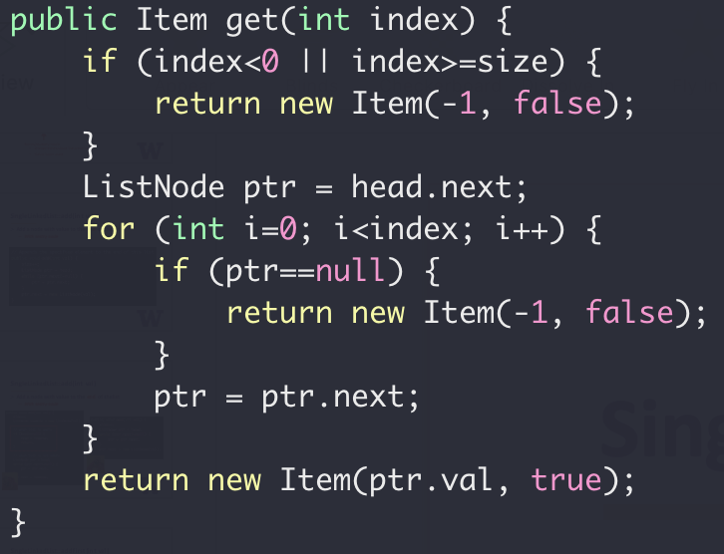
SingleLinkedList::get(int index)
Returns the element at the specified position in this list
Use sentry node
get(0) returns {2, true}
get(1) returns {5, true}
get(3) returns {-1, false}
?
h → 2 → 5 → 1 → N
p1

Slide 35
SingleLinkedList::get(int index)
Returns the element at the specified position in this list
h → 2 → 5 → 1 → N
How many stops to get list[2]?
For an array instead, how many stops to get array[2]?

Slide 36
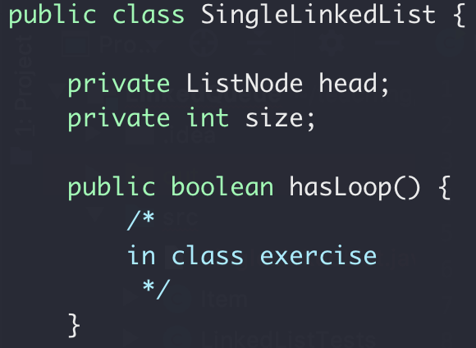
Linked List in-class lab 2
Given the head pointer (assuming dummy head node)
Find whether the list has a loop

Slide 37

Linked List in-class lab 2
Given the head pointer (assuming dummy head node)
Find whether the list has a loop
Head → 0 → 1 → 2 → 3 → 4 → 5
8
7
6

Slide 38
Linked List in-class lab 2
Find whether the list has a loop
p0
p0
p0
p0
p1
head → 0 → 1 → 2 → 3 → 4 → 5
p1
p1
8
7
6
p1

Slide 39
ADT Queue
Remove the limitation of queue size
Option 1: Better/smarter Algorithm
Option 1: Better/smarter Algorithm
Option 2: Different data structure

Slide 40
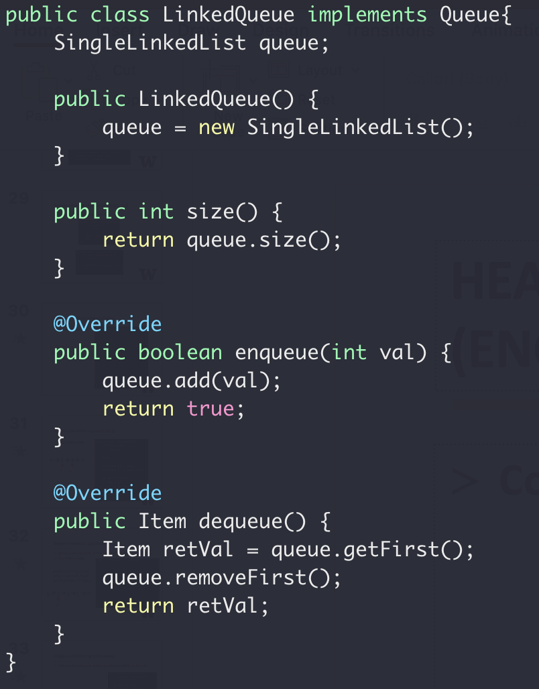
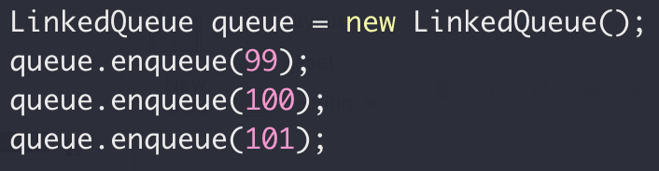
Queue with Linked List

Slide 41
ADT Queue
ADT Queue
Interface
enqueue()
dequeue()
size()
Implementation
Public Access
Linked List
Array

Slide 42
ADT List
So, What’s the difference between this two classes?

Slide 43
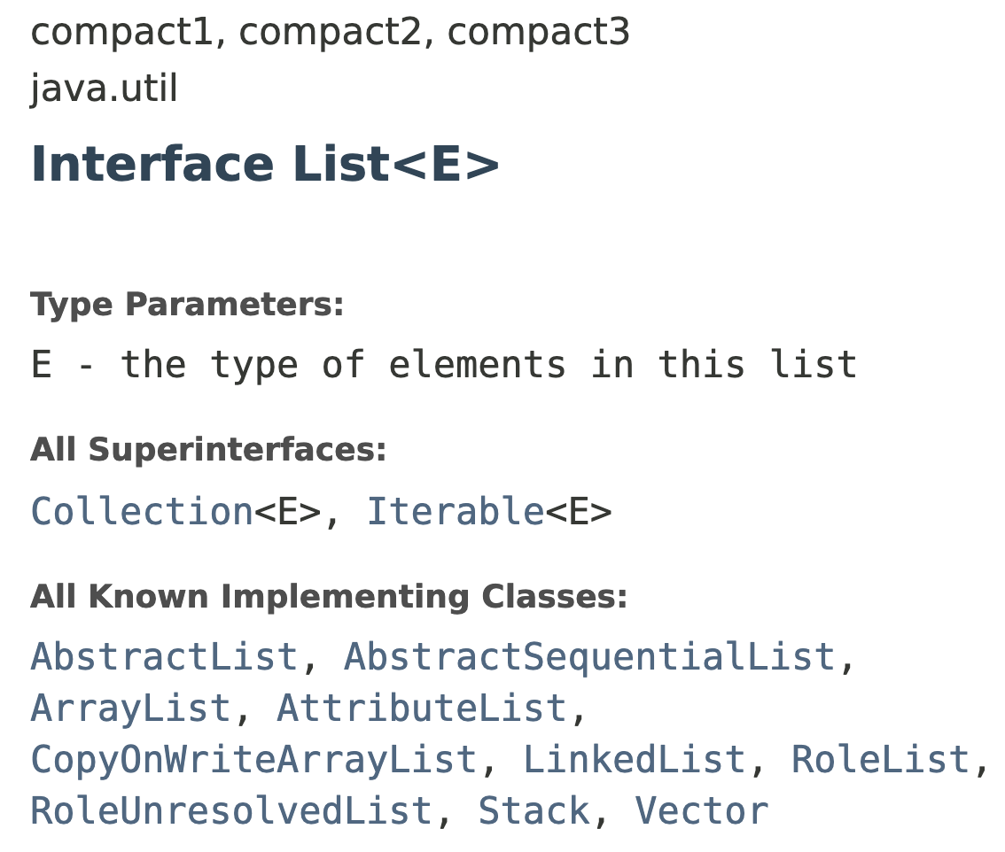
ADT List

Slide 44
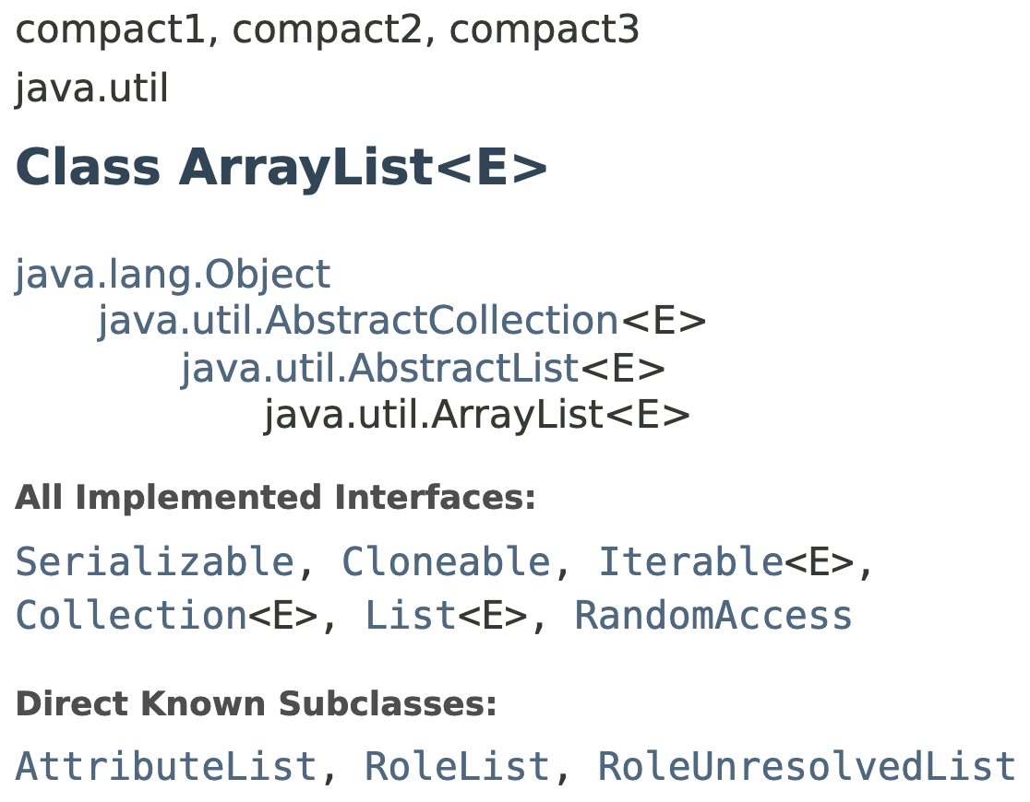
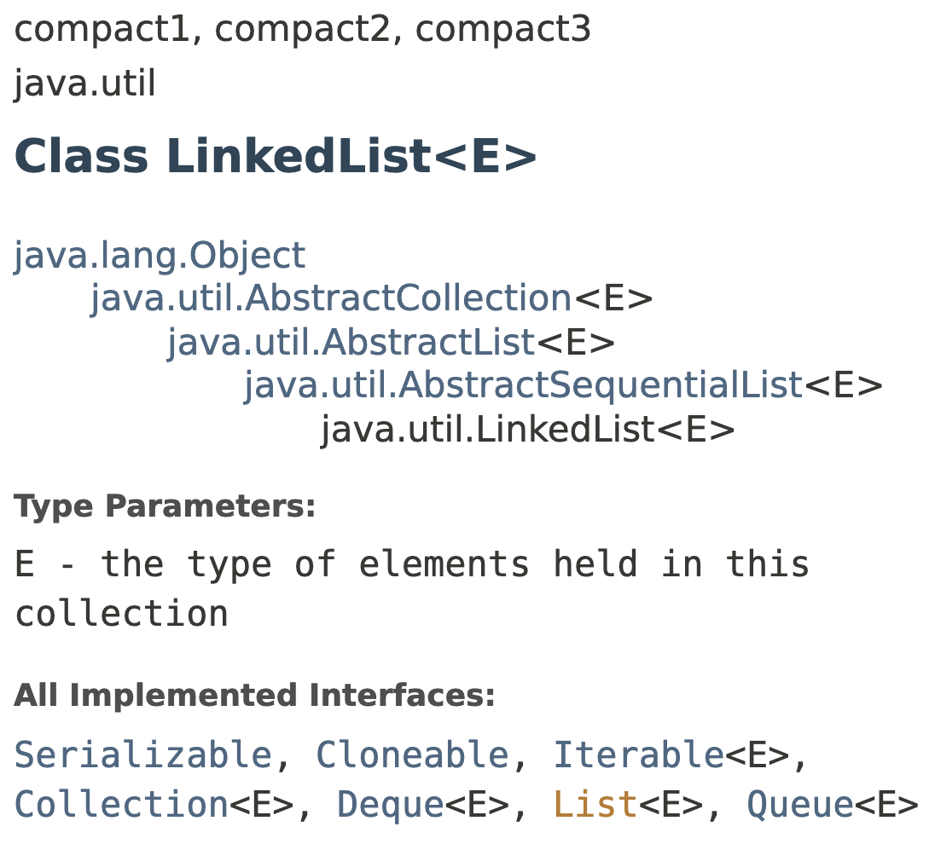
ADT List

Slide 45
List
An ordered
collection
Array → ArrayList
Linked Data → LinkedList

Slide 46
ArrayList
A list based on array
Constant time: size, isEmpty(), get(), set(), etc()
Linear time: add()
After add(0, 1)
1
After add(0, 2)
2
1
After add(0, 3)
3
2
1

Slide 47
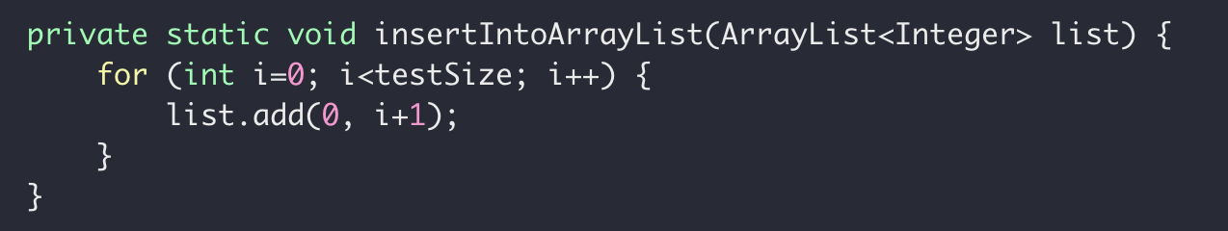
ArrayList
A list based on array
Constant time: get()
Linear time: add()
Dynamic size (allocate and copy)

Slide 48
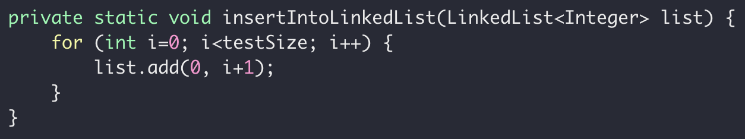
LinkedList
A list based on (double linked list)
Constant time: add()
Linear time: get()
Dynamic size (noop)

Slide 49
Performance Validation
add(0, val)
Linear time
head
null
add(0, val)
Constant time

Slide 50
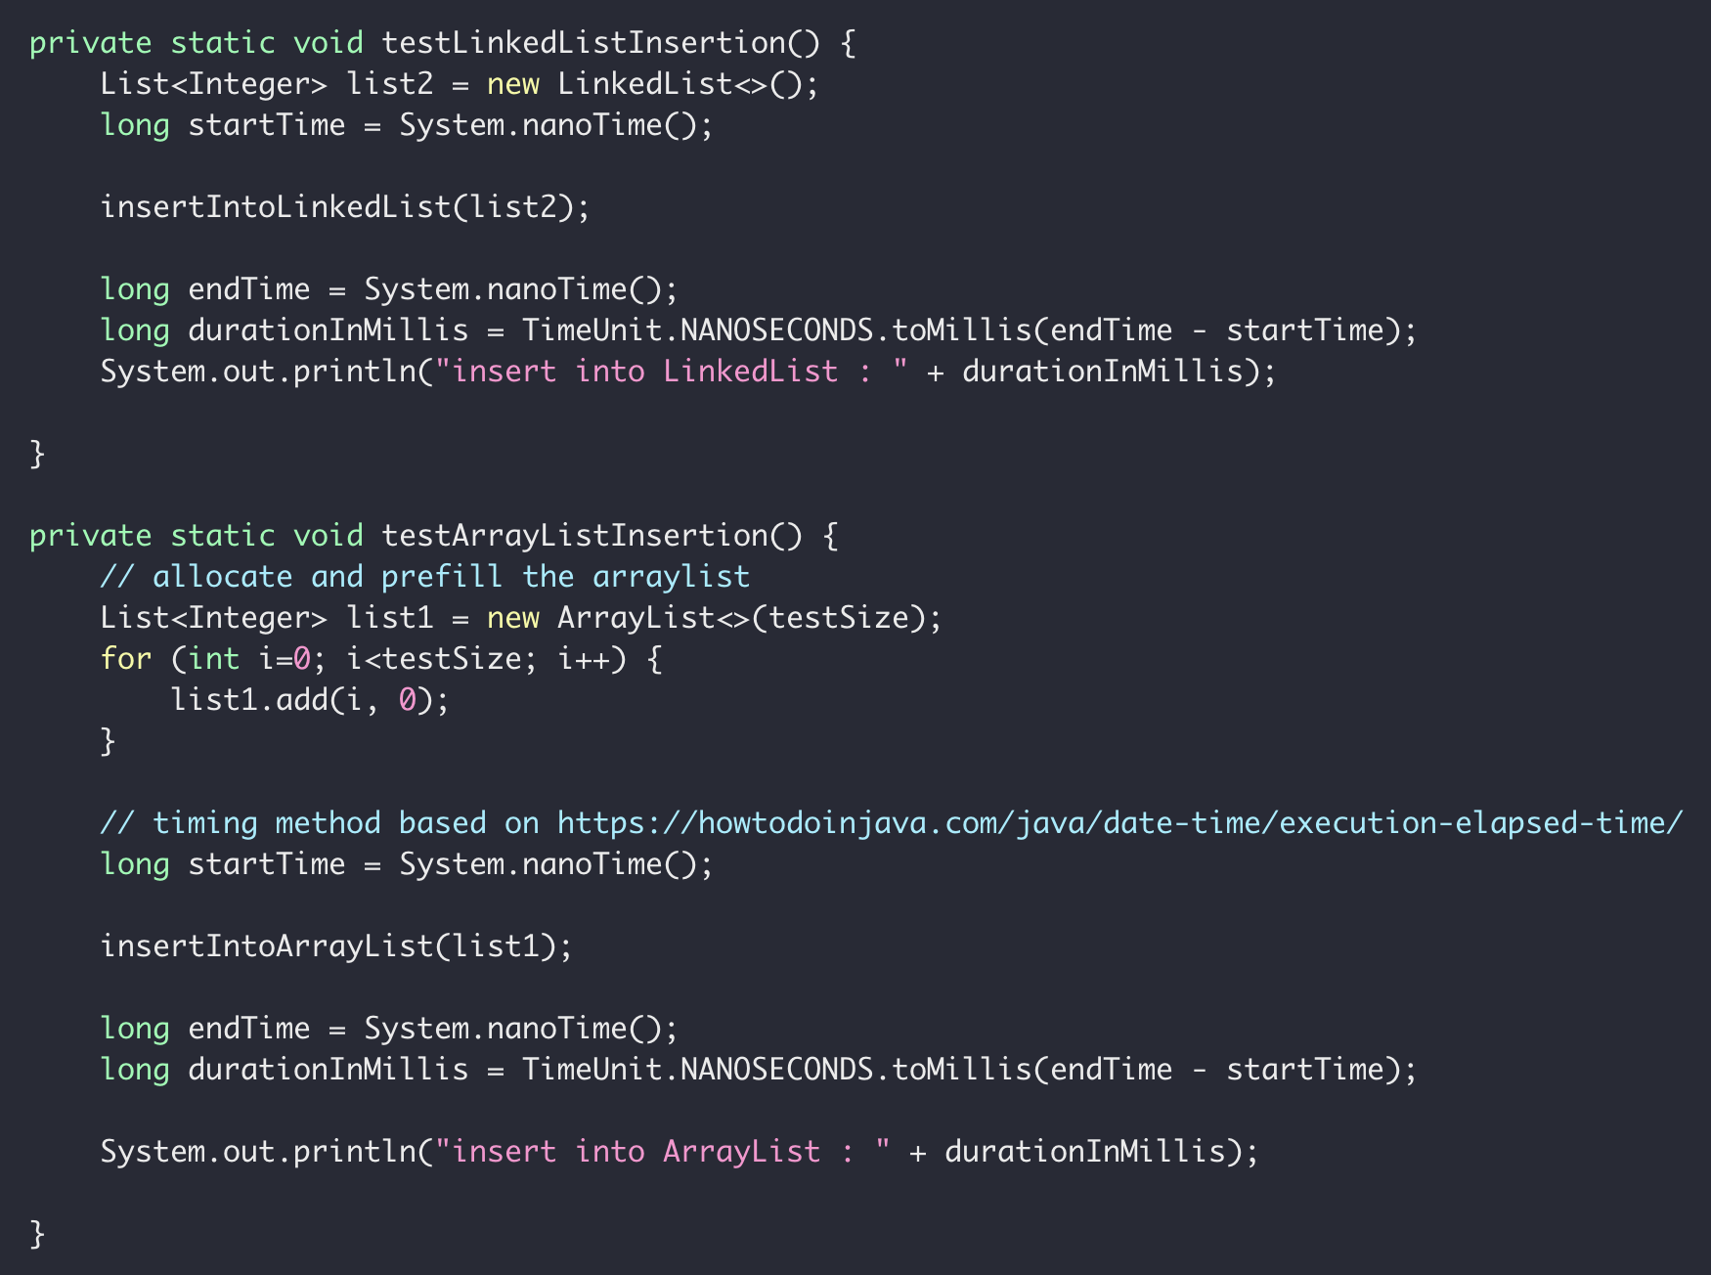
Performance Validation

Slide 51
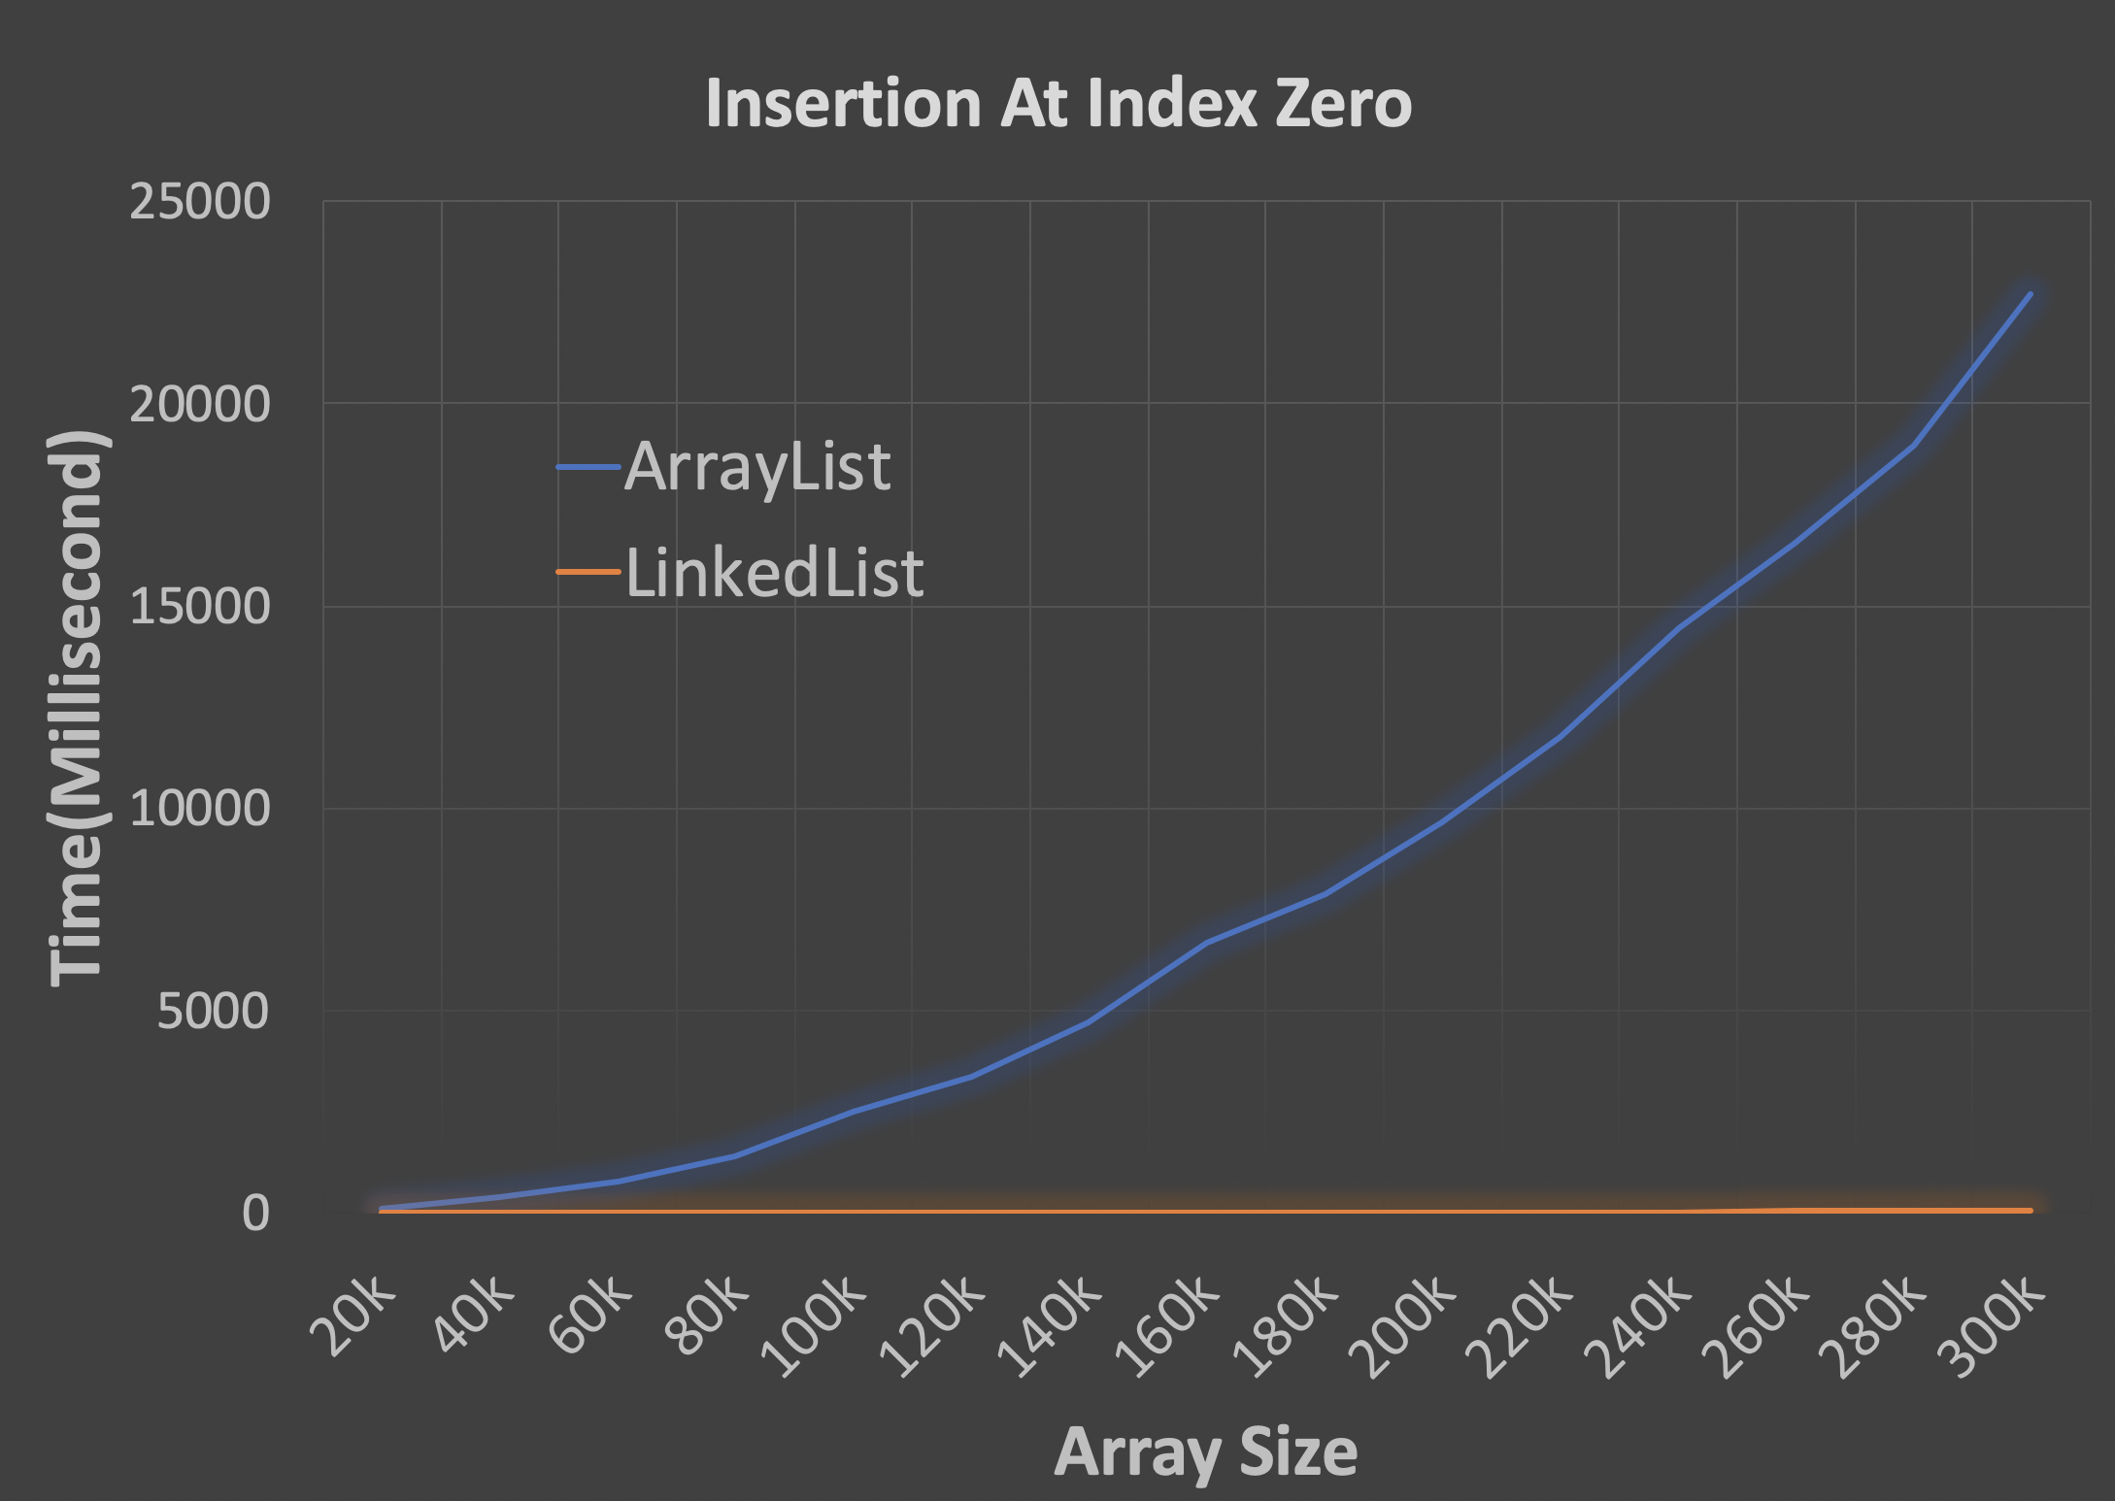
Performance Validation

Slide 52
ADT Summary
Abstract Data Type
Interface
Implementation
Public Access

Slide 53
Array vs List
Array:
Contiguous in memory
Fast random access
Fixed size
12
12
1
7
18
10
3
head
12
12
1
7
18
10
3
null
LinkedList:
Random addressed in memory
No random access
Size not fixed
More comparison between array and linked list

